Slide 1

Safeguarding Children's Spaces with AI Vision
An intelligent computer vision system designed to detect hazardous objects in children's environments before accidents happen, providing peace of mind for parents and carers.
גונקו דניאל 340969674
גבריס סבטלנה 342794732
סמיון אוסטרובסקי 342795754

Slide 2

The Challenge
Hidden Dangers in Safe Spaces
Parents and childminders face a constant challenge: identifying dangerous objects in children's rooms before they cause harm. Even in seemingly safe environments, small items, sharp objects, chemical bottles, or damaged cables can hide behind toys or lie on the floor.
These hidden hazards can lead to choking, injuries, or exposure to dangerous substances—often without warning.

Slide 3
References and Sources
The following academic papers formed the foundation of our research and development:
Article Name
About
Relevance
Link
AI-Powered Surveillance for Child Safety in Smart Homes
YOLOv5-based real-time detection of hazardous household objects to prevent child injuries.
This paper showed me how YOLO models can be applied for real-time detection of dangerous items. I adapted similar techniques to identify hazards in children's spaces with additional contextual awareness.
https://ieeexplore.ieee.org/document/10737980
Deep learning models for recognizing unsafe baby postures and nearby hazards in nurseries.
https://www.researchgate.net
Developing a Smart Nursery Application for Monitoring and Babies Care
I used this paper to understand how AI can monitor child environments and identify both risky behaviors and dangerous objects.
IoT and object identification enabled Smart Home Security System
YOLOv4-based system for recognizing hazardous items such as knives and medications in real time.
I used this research to compare detection accuracy between YOLO versions and select the best-performing architecture for my prototype.
https://www.researchgate.net/publication/36504603

Slide 4
Why Traditional Data Collection Fails
Privacy Concerns
Ethical Barriers
Rare Occurrences
Collecting real images from homes raises serious privacy issues for families.
Deliberately exposing children to dangerous situations for photography is unacceptable.
Most hazardous situations are infrequent and difficult to document authentically.
These limitations make synthetic data generation through GenAI models essential for creating a robust, safe, and privacy-preserving training dataset.

Slide 5



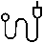
Four Critical Danger Categories
Choking Hazards
Sharp Objects
Small objects that could obstruct airways
knives and scissors that could cause cuts or puncture wounds
Chemical Dangers
Electrical Hazards
Cleaning products, detergents, or any chemical bottles that could be ingested or cause harm.
Exposed cables, torn adapters, damaged sockets—simulated safely for training purposes only.

Slide 6

Innovation Through Synthetic Data
No existing open dataset focuses specifically on hazardous objects in children's rooms.

Slide 7
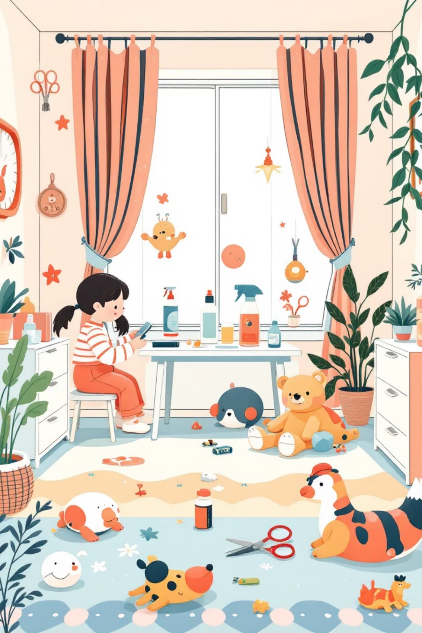
The ML Task: Object Detection for Safety
Input
Example Detection
Picture of a children's room
Battery on carpet → Bounding box + "Small choking hazard"
Output
Scissors on table edge → Bounding box + "Sharp object"
Bounding boxes around detected objects
Category labels from 4 danger types
Cleaning bottle near toys → Bounding box + "Chemical hazard"
Optional risk severity rating (low/medium/high)

Slide 8

Synthetic Data Generation Strategy
We employ advanced generative models including Stable Diffusion, ControlNet, and Inpainting techniques to create diverse children's room scenarios.
Controlled Variables
Multiple camera angles
Varied lighting conditions
Different clutter levels (tidy vs. toy-filled rooms)
Partial object occlusion (items behind toys, under furniture)
Negative examples (safe rooms without hazards for balanced training)

Slide 9
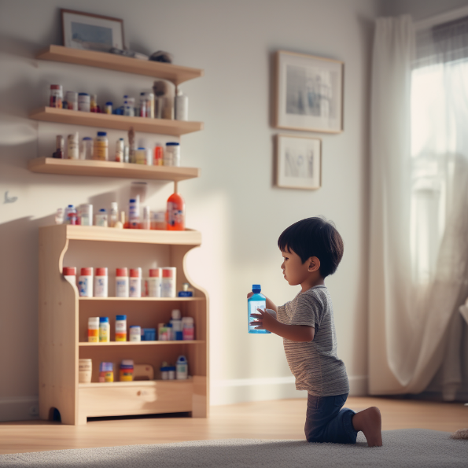
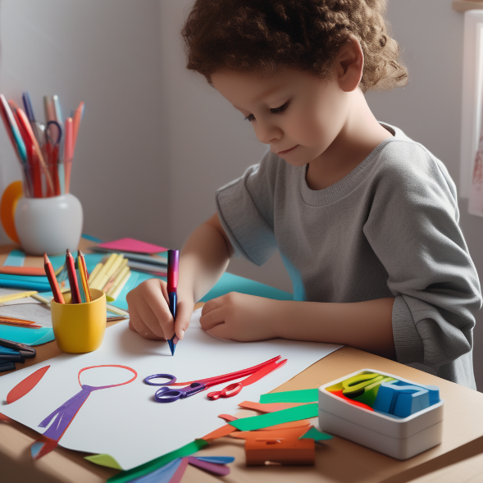
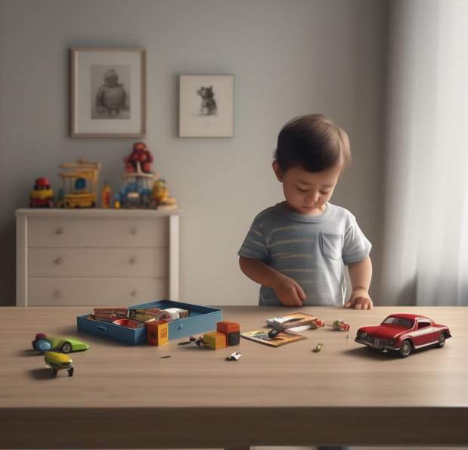
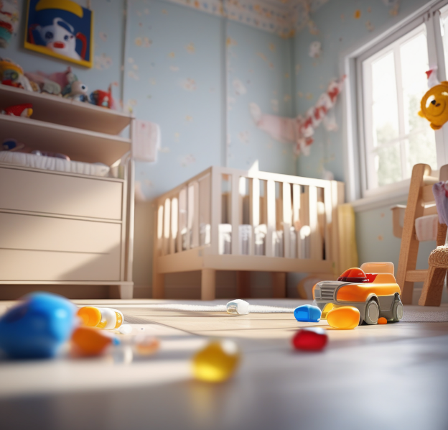

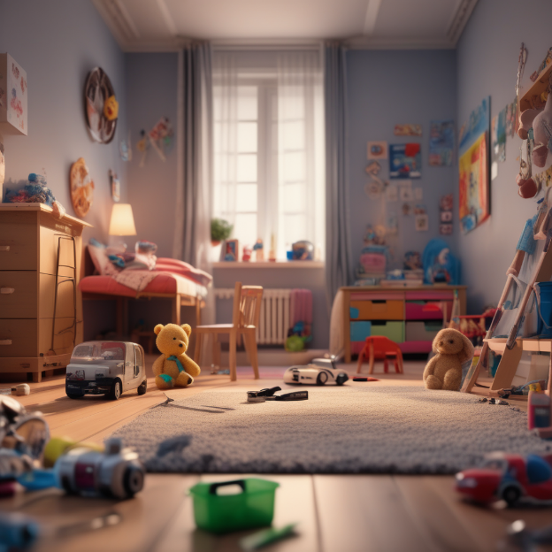
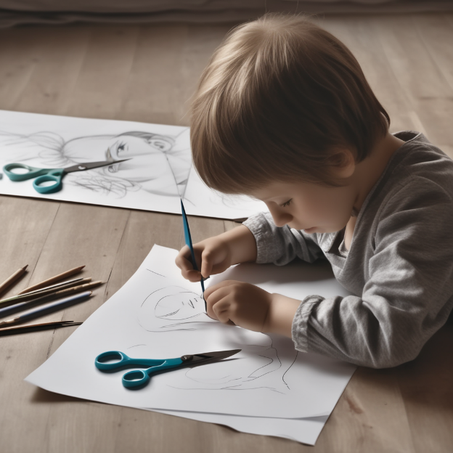
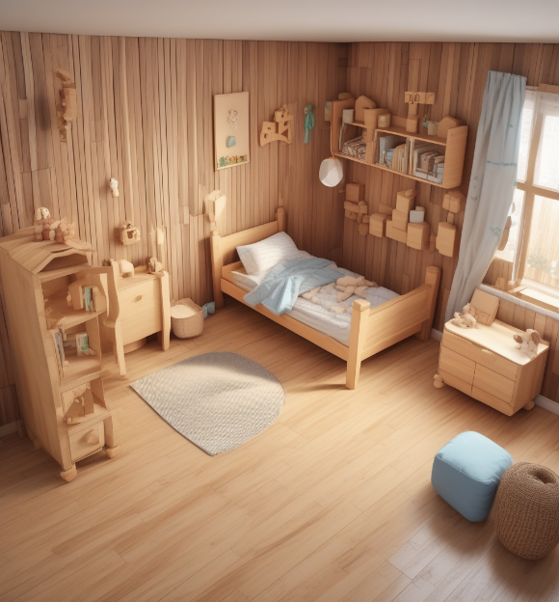
Sample data

Slide 10



Model Selection & Experimental Design
SDXL
Grounding DINO
CVAT
YOLOv8/v10

Slide 11
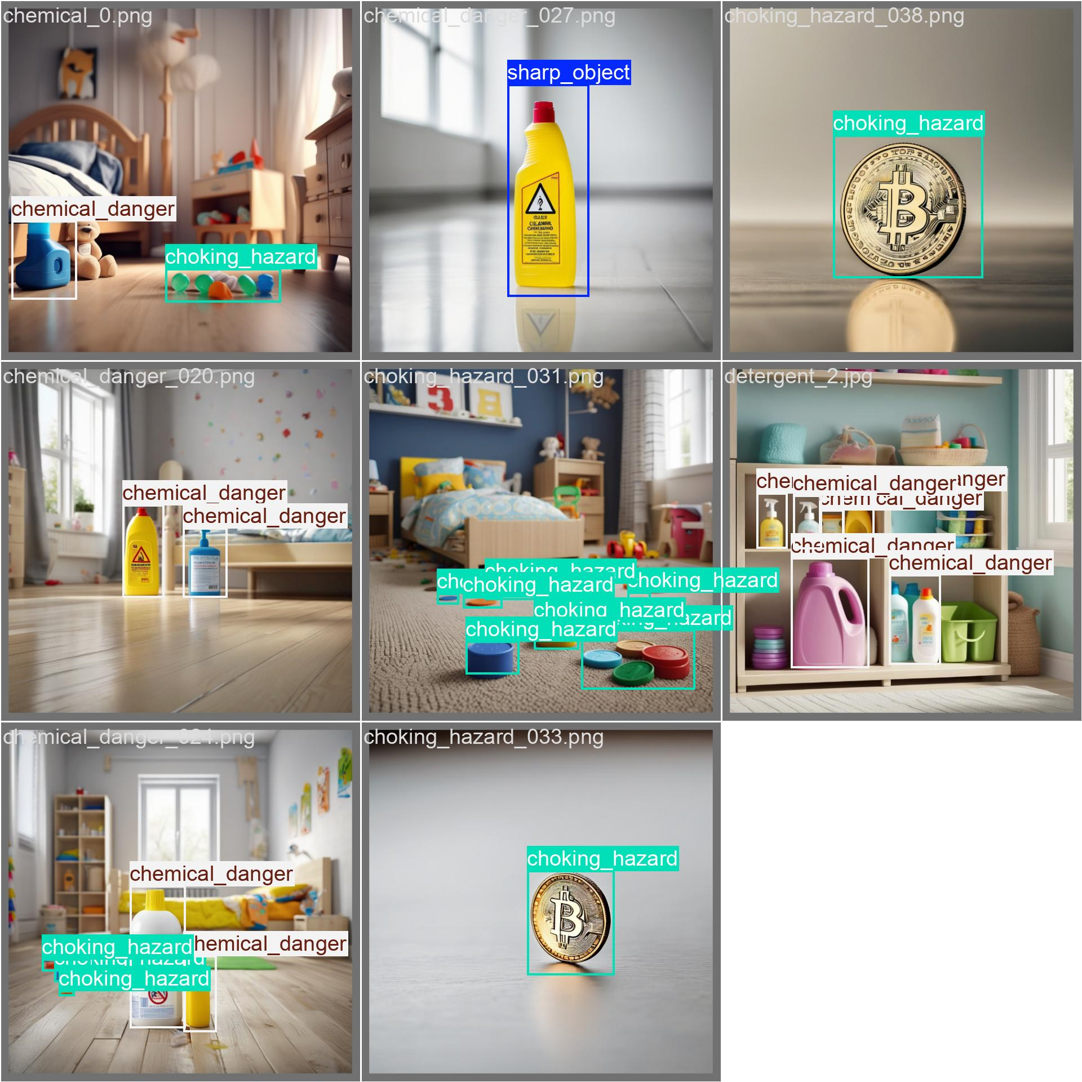
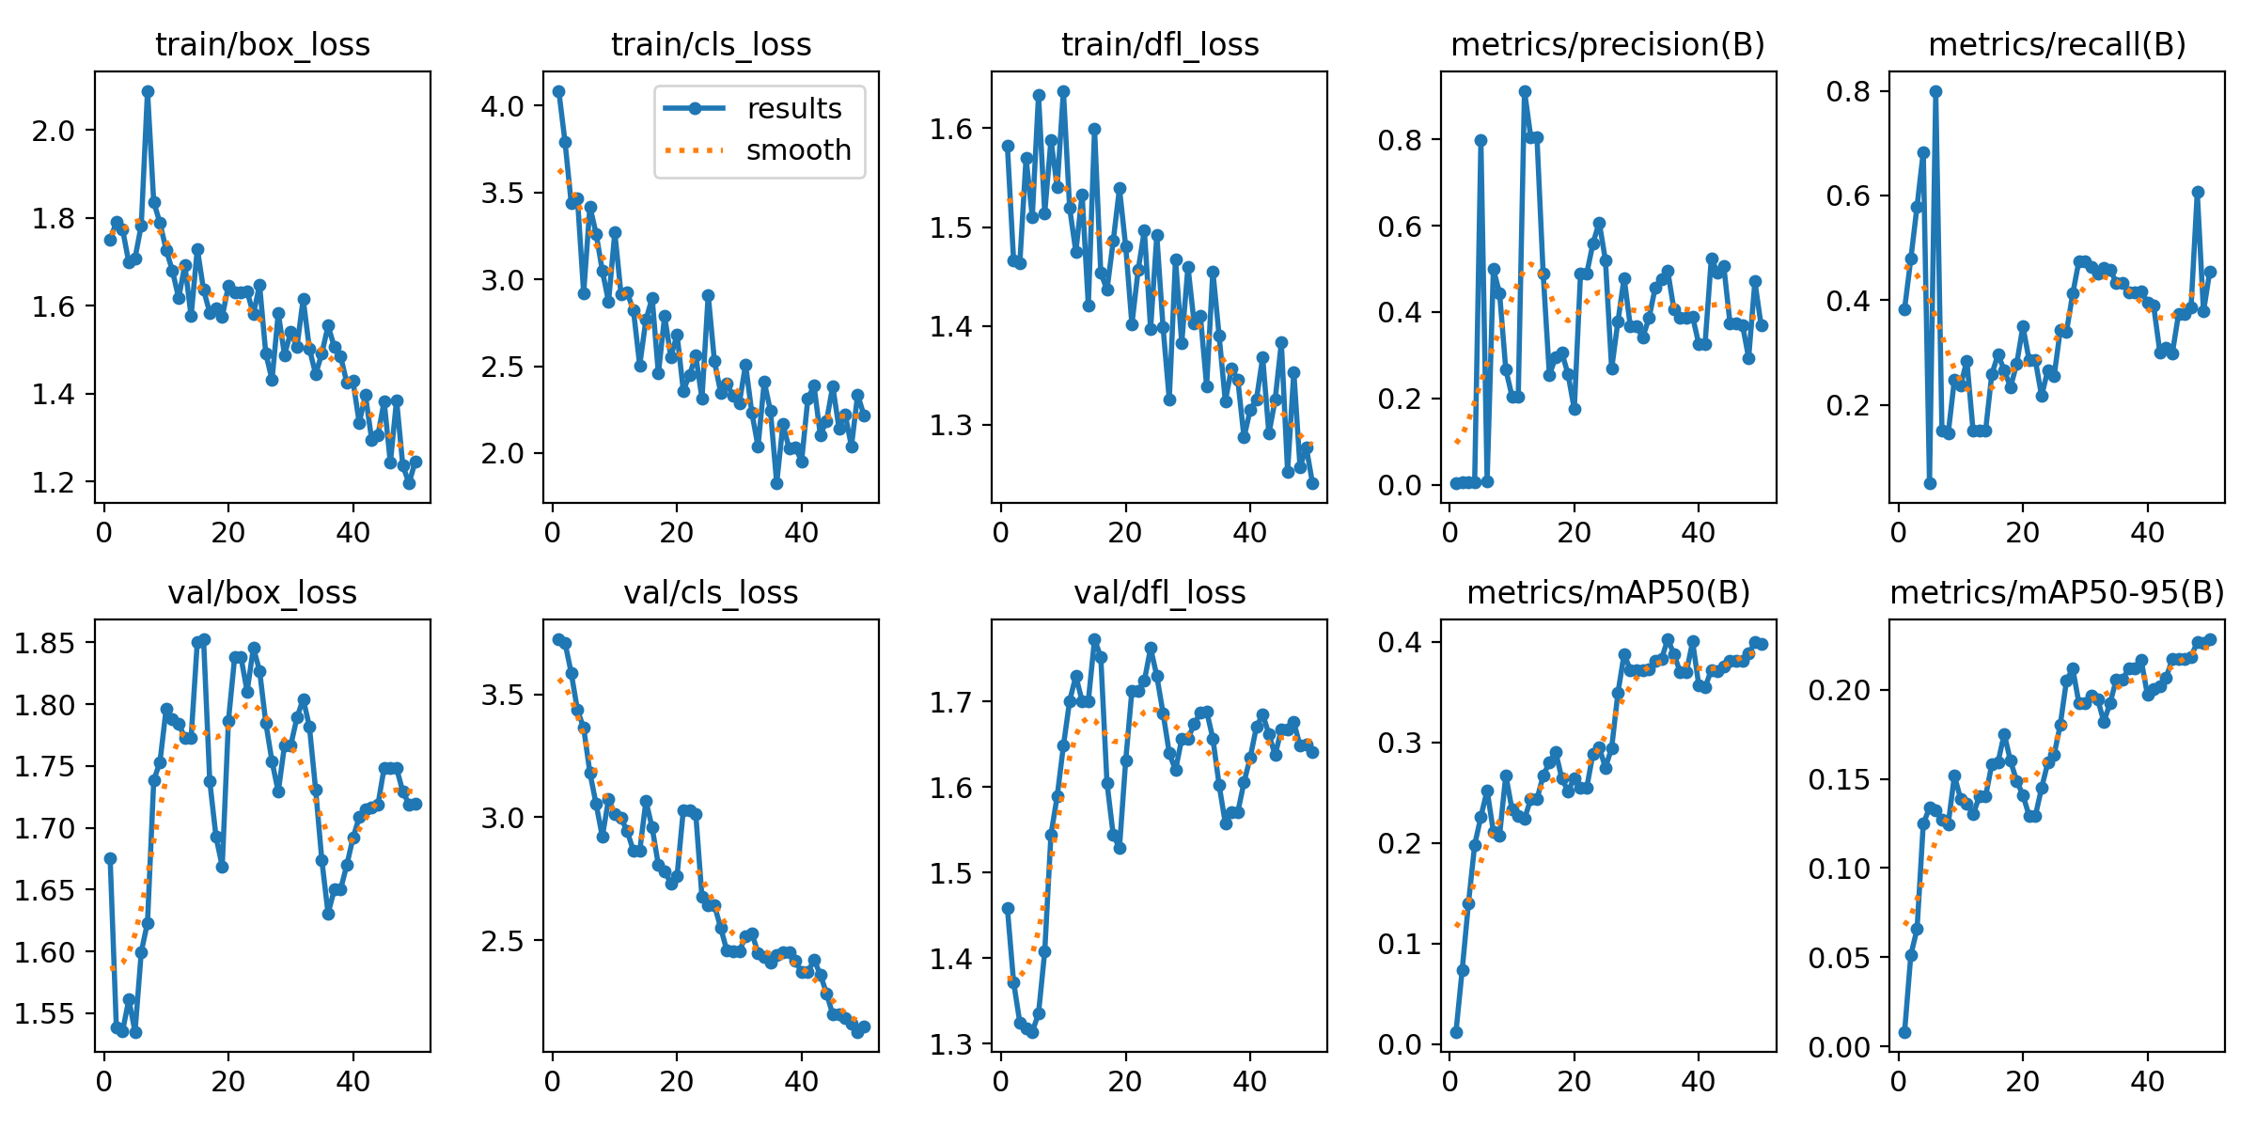
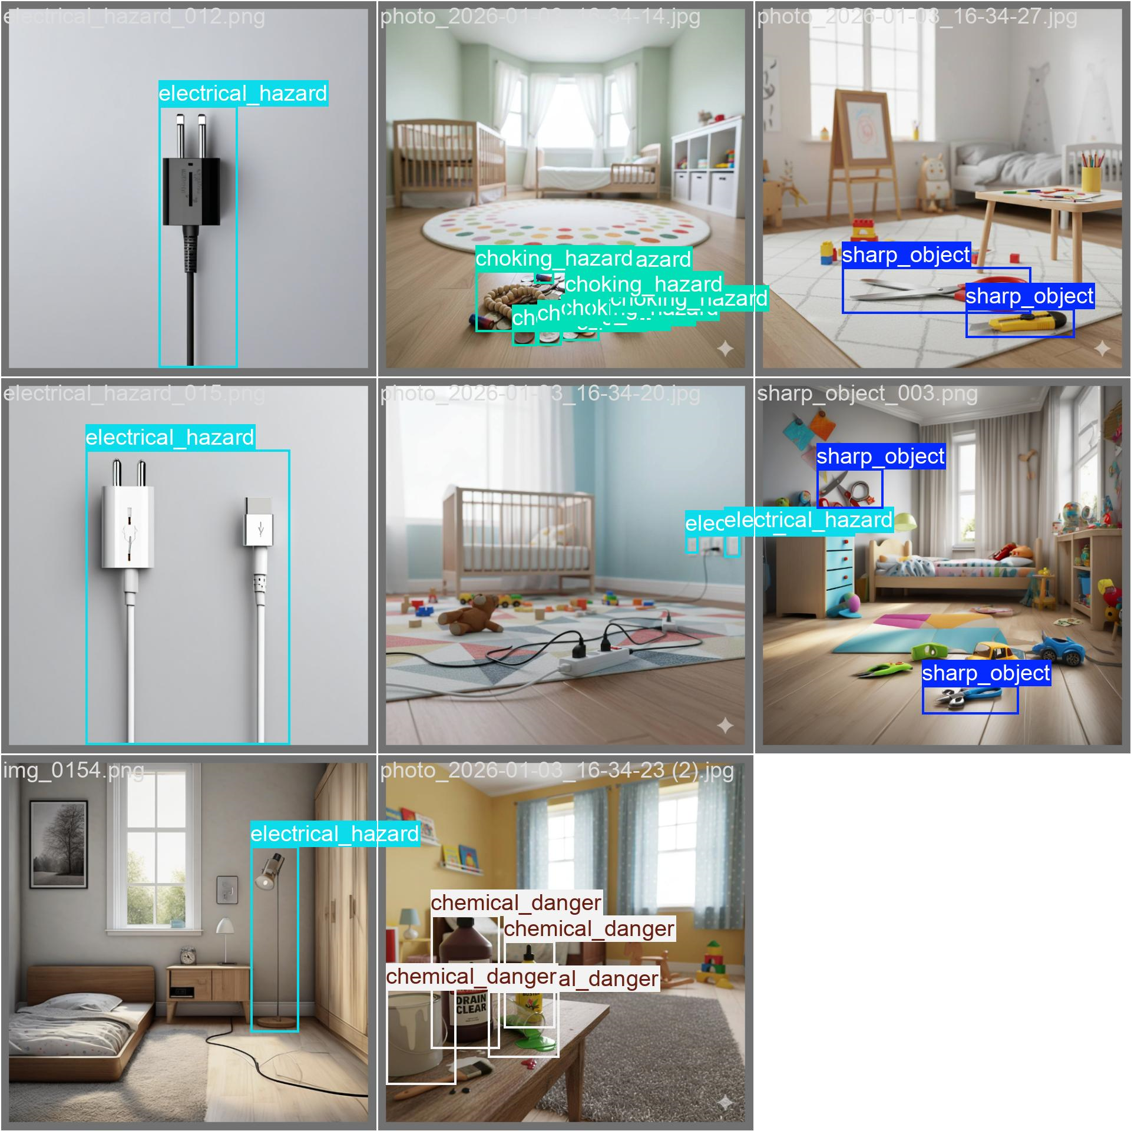
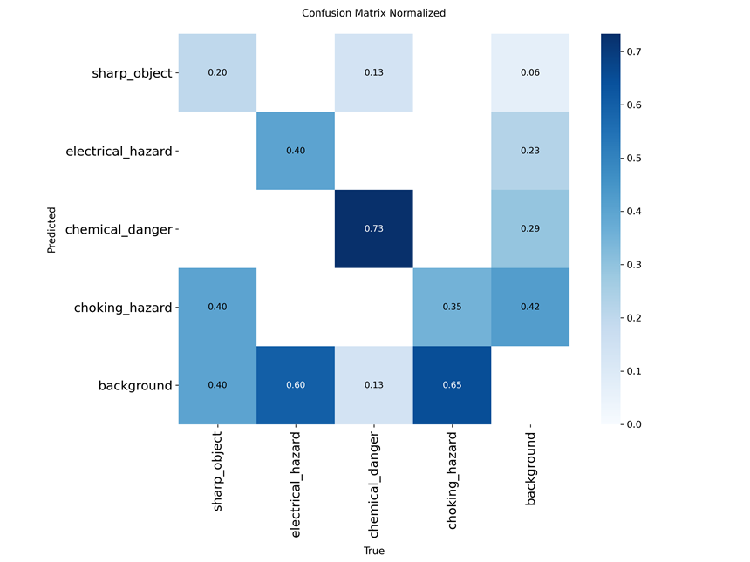
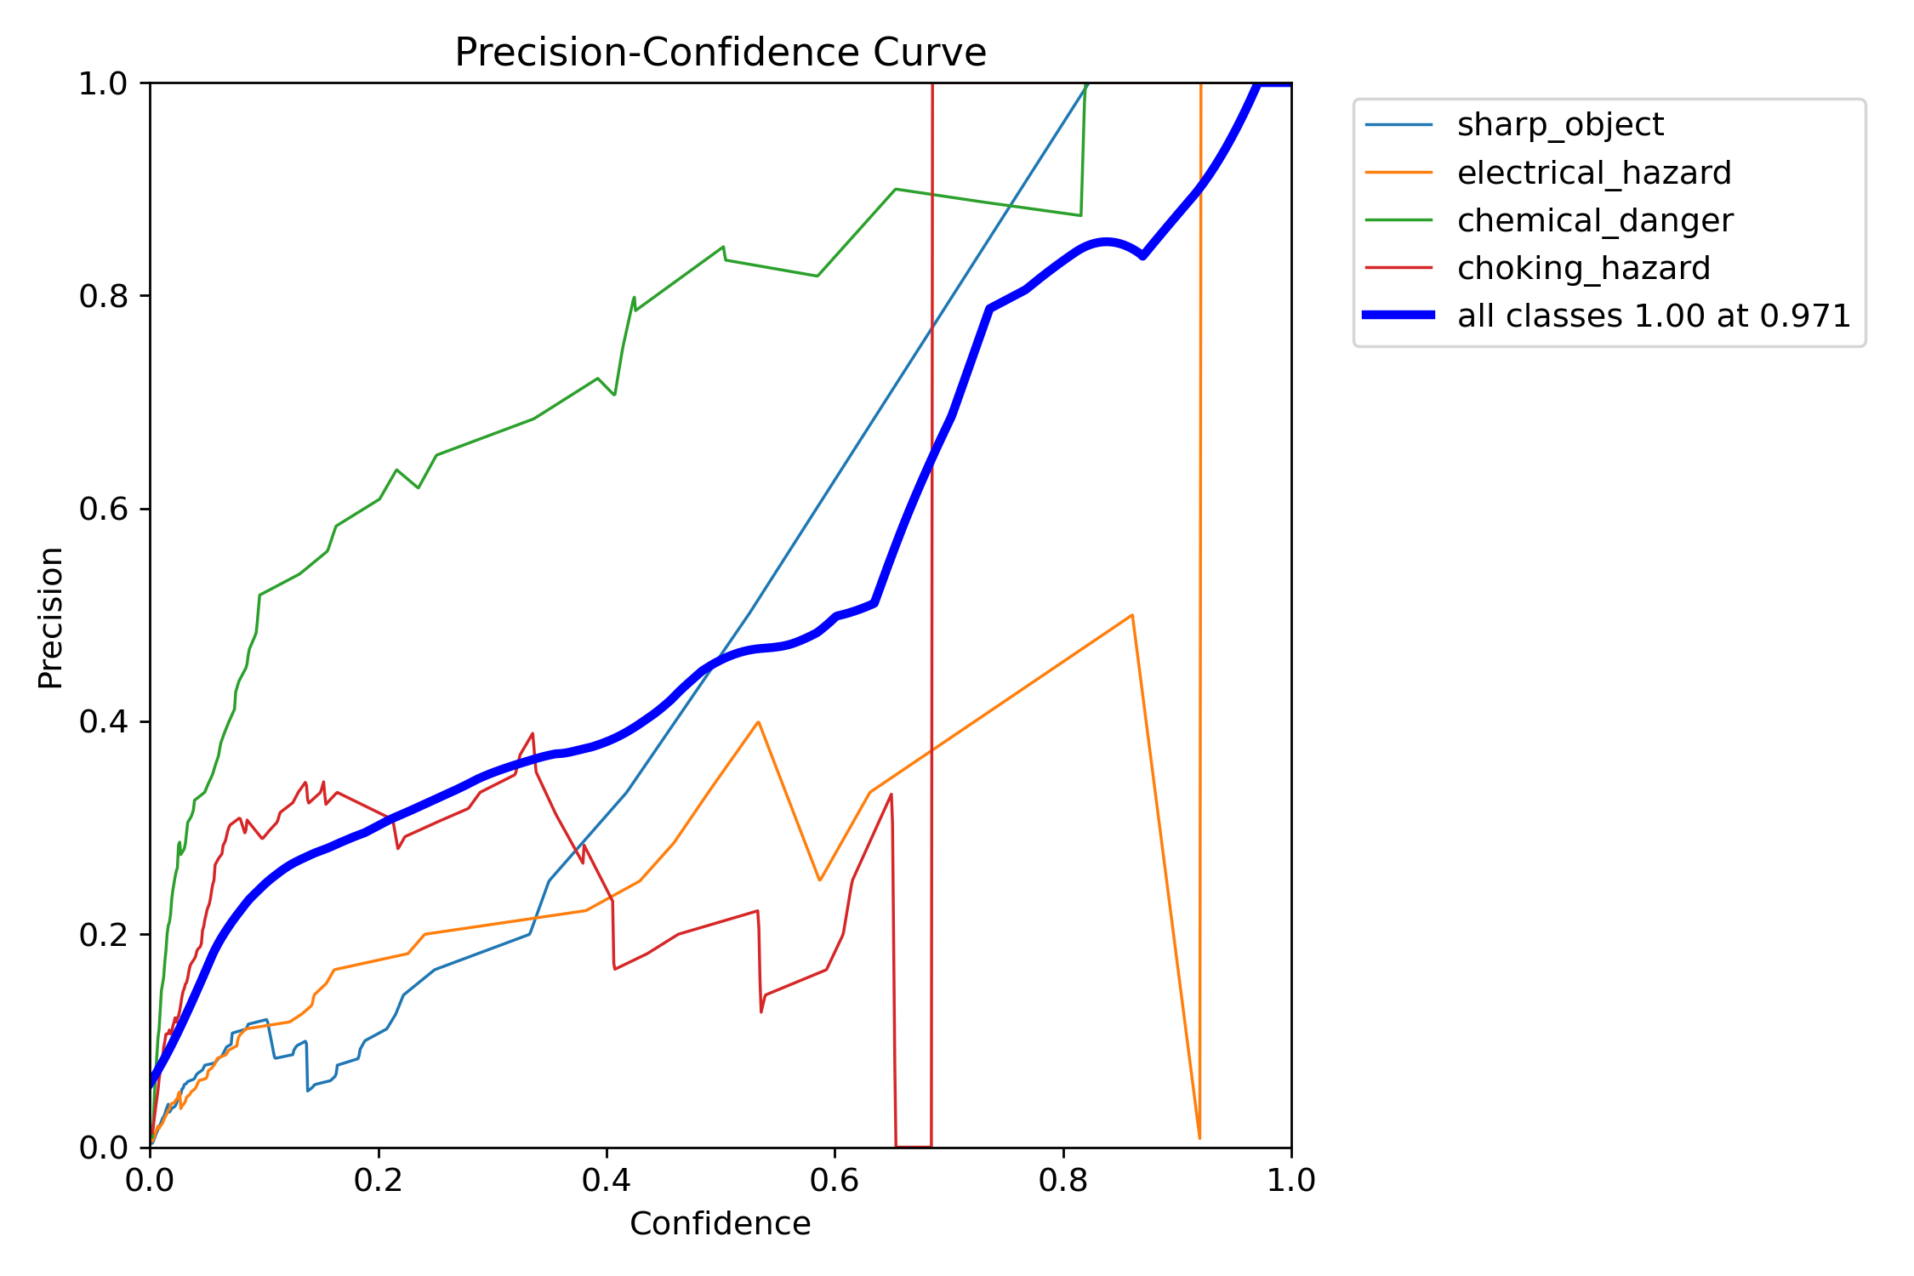
The results of a test models

Slide 12

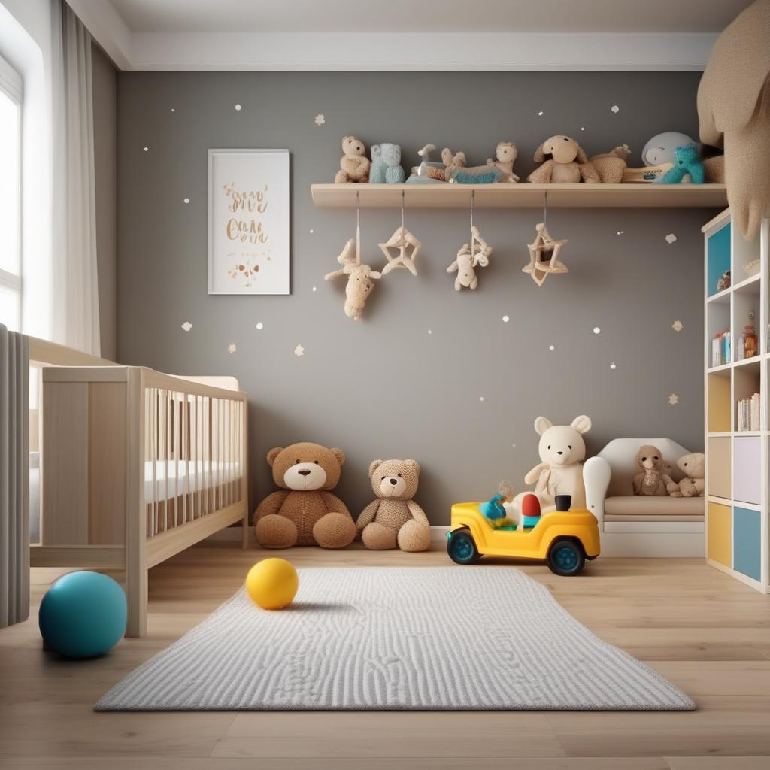
Future Work / Next Steps
 | Area | Planned Task | Goal
1 | Dataset Expansion | Generate more images with varied room layouts, lighting conditions, and camera angles | Improve model generalization
2 | New Hazard Classes | Add additional dangerous objects (medicines, knives, open sockets) | Extend system functionality
3 | Prompt Engineering | Improve prompt diversity and realism using different seeds and scene descriptions | Increase synthetic data quality
4 | Annotation Validation | Manually review and refine automatically generated bounding boxes | Reduce labeling noise
5 | Larger Detection Models | Train YOLOv8-S or YOLOv8-M models | Improve detection accuracy
6 | Data Augmentation | Apply augmentations such as rotation, scaling, blur, and lighting changes | Increase robustness
7 | Real-World Evaluation | Test the model on real household images | Validate practical usability

